Slide 1
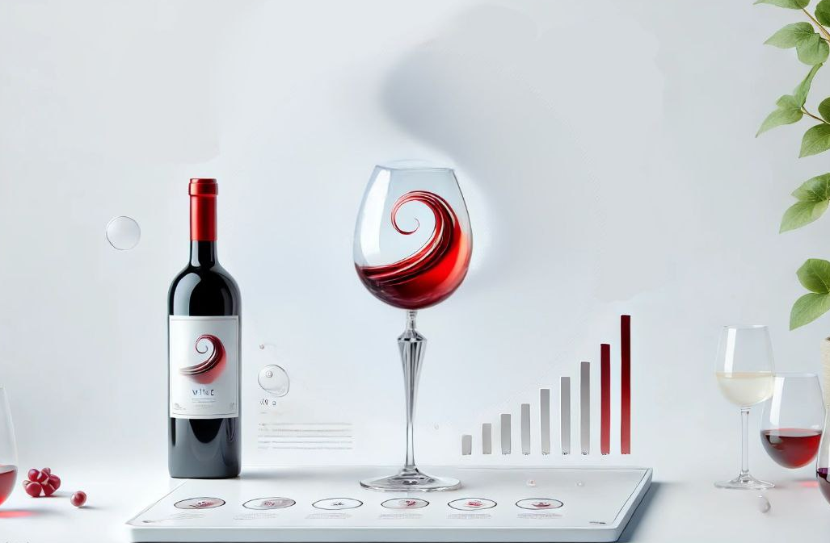
Artificial Neural Networks - Project
W12AIR-SM0721P
Wine quality classification using Artificial Neural Network
Autors in group:
Paweł Ozga
Pranav Pramod

Slide 2
Milestone
Presentation 1 (25.03.2025) Topic - Wine quality classification using ANN.
(8.04.2025/6.05.2025) Prepare code to next presentation.
Presentation 2 (20.05.2025) Multilayer prescription, function, back propagation etc.
(20.05.2-25/3.06.2025) Preprocessing set Test/Train/Validation.
Presentation 3 (17.06.2025) Project - Solution.

Slide 3
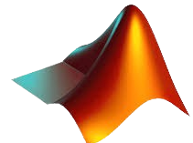


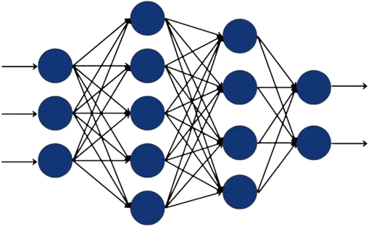
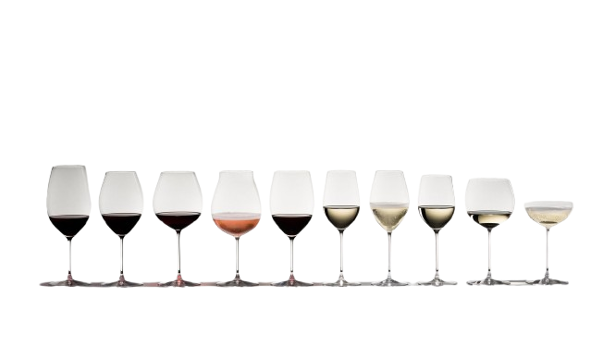
MATLAB Toolbox: Statistics and Machine Learning & Deep Learning
EXCEL Dataset : We train our model using DATASET (with numerous variables) containing various wine sample with features.
INPUT
(features)
OUTPUT
(classes)
Dateset : by Andrewmchen and Mateiz from GitHub
link: https://github.com/mlflow/mlflow-example/blob/master/wine-quality.csv

Slide 4
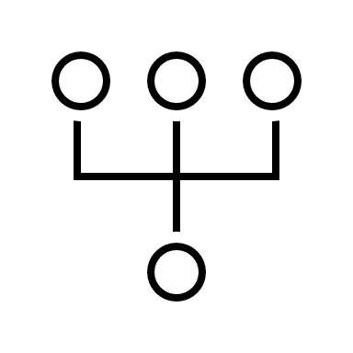


Division of responsibilities
Paweł Ozga
Pranav
Research about MLP network
Effect of Bias in Neural Network
Back propagation
Levenberg – Marquardt algorithm
Coding: both
Model Development & training
Documentation & presentation
Dataset & Handling
Coding: both
Model Development & training
Documentation
Preprocessing
Presentation

Slide 5
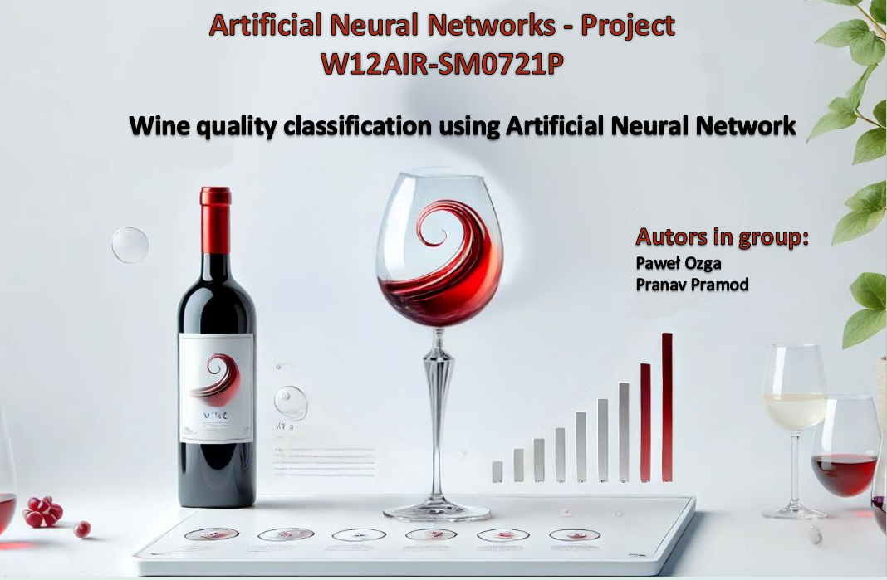
Any Questions?

